Slide 1
Reverse Engineering Based Intelligent Cyber Threat Detection and Analysis Platform
Team Details
717823F153 - Srinath B
717823F154 - Sunil Amarthya D
717823F160 - Vishnu Neelan L
717823F163 - Yokeshwaran G
Supervisor
Ms.Sogy K.Idicula, M.Tech
Assistant Professor,
Department of Information Technology,
Karpagam College of Engineering,
Coimbatore - 641032

Slide 2
Abstract
Proposes an Reverse Engineering - Based Cyber Threat Intelligence Platform to analyze suspicious APK files, URLs, emails, and system logs through a centralized security dashboard.
Utilizes reverse engineering and static malware analysis to identify malicious permissions, embedded URLs, API calls, and other indicators of compromise (IOCs).
Integrates Threat Intelligence and a Risk Correlation Engine to combine findings from multiple security modules and accurately assess the severity of cyber threats.
Provides real-time threat detection, security alerts, and risk visualization, enabling organizations to improve incident response and strengthen their overall cybersecurity posture.

Slide 3
Objectives
Develop an integrated Cyber Threat Intelligence Platform for centralized detection and analysis of cyber threats.
Perform reverse engineering and static malware analysis on Android APKs to identify malicious permissions, APIs, embedded URLs, and suspicious code.
Detects malicious URLS and phishing attacks using domain reputation,URL analysis ,and threat intelligence techniques.
Correlate findings from multiple security modules to generate real-time risk scores, alerts, and actionable insights through a centralized dashboard.

Slide 4
Literature Survey
Title of the Project | Author Name and Year | Problem Defined | Algorithm / Method Used | Outcome of the Project
Malware Detection: A Framework for Reverse Engineered Android Applications | Al-Hadhrami et al. (2022) | Android applications can hide malicious code that is difficult to detect before installation. | Reverse Engineering, Static APK Analysis | Detects malicious APKs using manifest, permissions, and decompiled code.
Android Malware Detection Using Static Analysis Techniques | Sharma et al. (2024) | Malware applications bypass traditional antivirus detection. | Static Analysis, Permission Analysis | Improves malware detection without executing the application.

Slide 5
Literature Survey
Title of the Project | Author Name and Year | Problem Defined | Algorithm Used | Outcome of the Project
Malicious URL Detection Using Machine Learning | Kumar et al. (2024) | Users unknowingly access phishing and malware-hosting websites. | URL Feature Analysis, Machine Learning | Accurately identifies malicious URLs before user access.
Phishing Website Detection Using URL and Content Analysis | Chen et al. (2023) | Fake websites steal user credentials through brand impersonation. | URL Similarity Analysis, HTML Content Analysis | Detects phishing websites with high accuracy and reduces cyber fraud.

Slide 6
Literature Survey
Title of the Project | Author Name and Year | Problem Defined | Algorithm Used | Outcome of the Project
Cyber Threat Intelligence: Challenges and Opportunities | Husari et al. (2024) | Organizations struggle to identify and correlate emerging cyber threats. | Threat Intelligence Framework | Enhances threat detection using Indicators of Compromise (IOCs).
Security Information and Event Management (SIEM): A Survey | Ahmad et al. (2022) | Security logs from multiple devices are difficult to analyze manually. | Event Correlation, Log Analysis | Enables centralized monitoring and faster incident response.

Slide 7
Literature Survey
Title of the Project | Author Name and Year | Problem Defined | Algorithm Used | Outcome of the Project
Endpoint Detection and Response: Current Trends | Singh et al. (2023) | Endpoint devices are vulnerable to ransomware and malware attacks. | Endpoint Monitoring, Behavioral Analysis | Detects suspicious processes and abnormal system activities.
Static Analysis Techniques for Android Malware Detection | Ali et al. (2021) | Dynamic malware analysis requires high execution time and resources. | Static Code Analysis | Performs faster malware detection using source code inspection.

Slide 8
Literature Survey
Title of the Project | Author Name and Year | Problem Defined | Algorithm Used | Outcome of the Project
Threat Intelligence Platform for Advanced Cybersecurity | Zhang et al. (2023) | Lack of a centralized repository for known cyber threats and attack indicators. | Threat Intelligence Database | Improves cyber threat detection using malicious domains, IPs, and malware signatures.
Android Reverse Engineering for Malware Investigation | Mohammed et al. (2023) | Malware hides malicious behavior using code obfuscation techniques. | APKTool, JADX, Reverse Engineering | Extracts hidden code and detects suspicious APIs, permissions, and embedded URLs.

Slide 9
Problem Statement
Organizations face an increasing number of cyber threats, including malware, phishing attacks, malicious URLs, and unauthorized applications.
Existing security solutions operate independently, making it difficult to correlate security events and identify complex attacks.
Manual investigation of suspicious files and network activities is time-consuming, error-prone, and delays incident response.
There is a need for a centralized cybersecurity intelligence platform that performs automated analysis, correlates threats, and provides real-time risk assessment and security alerts.

Slide 10
Requirement Specification
Software specification :
Application Required : Database
1.Visual Studio Code 1.PostgreSQL
Backend Technologies Reverse Engineering Tools
1.Java 17 1.JADX
2.Spring Boot 2.Apktool
3.Spring Security Development Tools
4.Maven 1.Git
Frontend Technologies 2.Postman
1.React.js 3.Maven
2.Tailwind CSS

Slide 11
Requirement Specification
Hardware specification :
CPU
AMD Ryzen 5 (Minimum)
AMD Ryzen 7 (Recommended)
RAM
8GB DDR4 (Minimum)
16GB DDR4 (Recommended)
STORAGE
20GB Free SSD Space (Minimum)
50GB Free SSD Space (Recommended)

Slide 12
Implementation Details(Modules)
Module 1 : User Authentication: Provides secure user registration and login with role-based access control ,ensuring only authorized users can access the cybersecurity platform.
Module 2 : APK Reverse Engineering Module (JADX & Apktool): Extracts Android application components such as permissions ,API calls, activities , services, URLs, Strings, and manifest information for security analysis.
Module 3 : Static Malware Analysis module: Analyzes the extracted features to identify suspicious permissions ,malicious API calls , code patterns, assigns an initial malware risk score.
Module 4 : Threat Intelligence & Risk Correlation Module : Compare extracted indicators of Compromise(IOCs) with the threat intelligence database , performs URL analysis , and generates the final security risk score.
Module 5 : Dashboard & Report Generation Module : Displays malware analysis results , threat statistics ,security alerts and generates downloadable PDF reports for further Investigation.

Slide 13
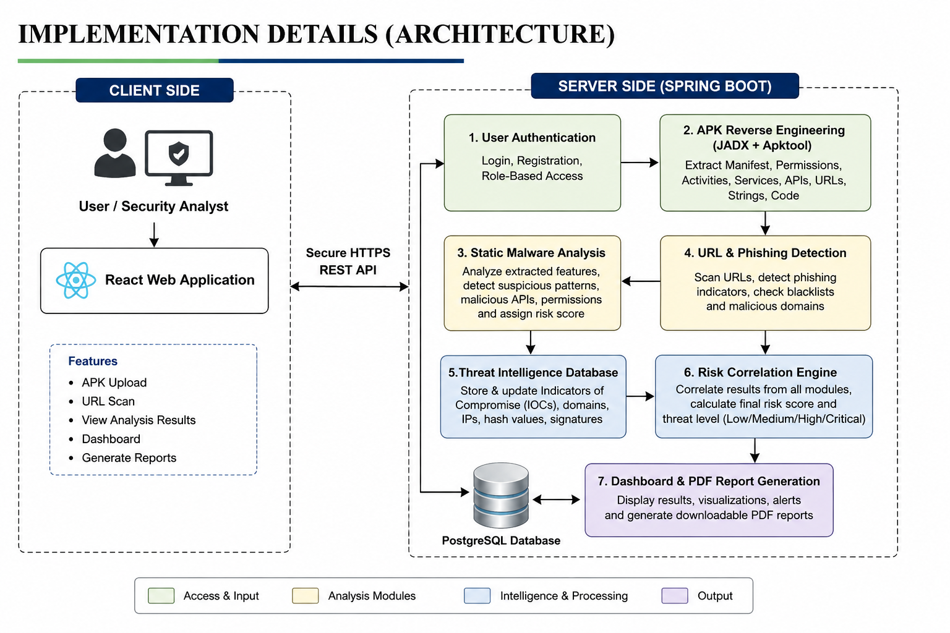
Implementation Details(Architecture)

Slide 14
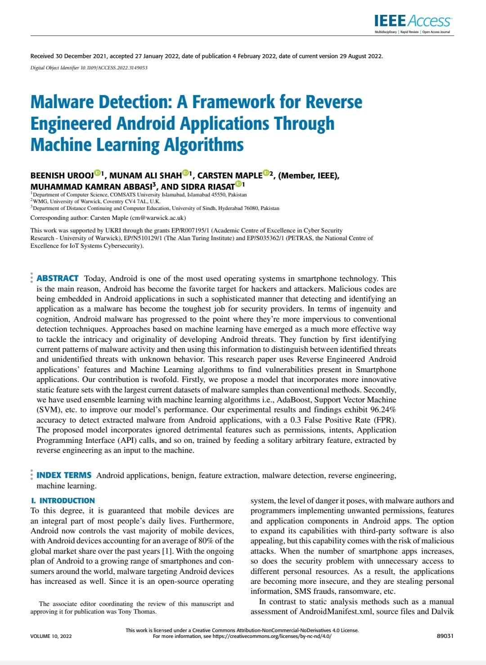
Journal Base Paper selection
Particular | Details
Paper Title | Malware Detection: A Framework for Reverse Engineered Android Applications Through Machine Learning Algorithms
Authors | Aseel Al-Hadhrami, Ali Dehghantanha, Kim-Kwang Raymond Choo, et al.
Journal | IEEE Access
Publisher | IEEE Xplore Digital Library
Year of Publication | 2022
DOI | 10.1109/ACCESS.2022.3149053
Research Domain | Reverse Engineering, Android Malware Analysis, Cybersecurity
Methodology | Reverse Engineering, Static Malware Analysis, Machine Learning
Reason for Selection | Provides a strong framework for Android APK reverse engineering and static malware detection, which aligns with the proposed project objectives.
Project Extension | Threat Intelligence, URL Scanner, Phishing Detection, Risk Correlation Engine, Endpoint Monitoring, Security Dashboard

Slide 15
Base References
A Lightweight and Multi-Stage Approach for Android Malware Detection Using Non-Invasive Machine Learning Techniques," IEEE Access, 2023.
Performance-Oriented and Sustainability-Oriented Design of an Effective Android Malware Detector," IEEE Access, 2024.
DeepImageDroid: A Hybrid Framework Leveraging Visual Transformers and CNNs for Robust Android Malware Detection," IEEE Access, 2024.
Android Malware Detection Method Combining Multi-Frequency Features and Convolutional Neural Networks," IEEE Access, 2025.
A Novel Machine Learning Approach for Android Malware Detection Based on the Co-Existence of Features," IEEE Access, 2023.

Slide 16
THANK YOU!

